Slide 1
AGM
Coleridge families (CF)
22 November 2021

Slide 2
Agenda
Introduction to the Committee Members
Activity Report for the last year (to September 2021)
Presentation and Approval of Accounts
School Plan (from the head teacher) and outline of support requested from Coleridge Families
Spending Plans
Vacant Roles on the Committee
AOB

Slide 3
Introduction to Committee Members
Co-Chairs – Ayla Us and Joanna Shakhmin
Treasurers – James Merryweather, Kai Simmons, Cristina Aldea, Marielle Drier, Enrico Da Vita
Secretary – Andrew Day
Event Management and Reps Coordinator – Mel Salomou
Coleridge Merchandise – Victoria Roberts
Link Governor – Georgia Norton
Coms – Cindy dos Santos (Facebook and Newsletter), Susan Jones (Instagram)
Website – Sarah Wiley
Sponsorship – Yuri Shakhmin and Joanna Shakhmin
School’s Wish List – Nora Zeidan

Slide 4
ACTIVITY REPORT for the Year (to September 2021)
Despite this year corresponding to period of various levels of restrictions that prevented us from hosting in person school wide events like Fireworks or Summer Fair, Coleridge Families organised multiple events and activities
The aim was to try and bring the school community together more than large scale fundraising, however we did manage to raise funds along the way

Slide 5
ACTIVITY REPORT
Activities included:
Pumpkin Trail - NEW
Coleridge Cookbook – NEW
Christmas Card Project
Christmas Parties, including gifts for children from Reception to Y2
Music Bingo - NEW
Online Quiz
The Cultures of Coleridge Podcast - NEW
Joke Book - NEW
Easter Trail - NEW
Pet Show - NEW
Summer Auction
End of Year entertainment for children at school - NEW

Slide 6
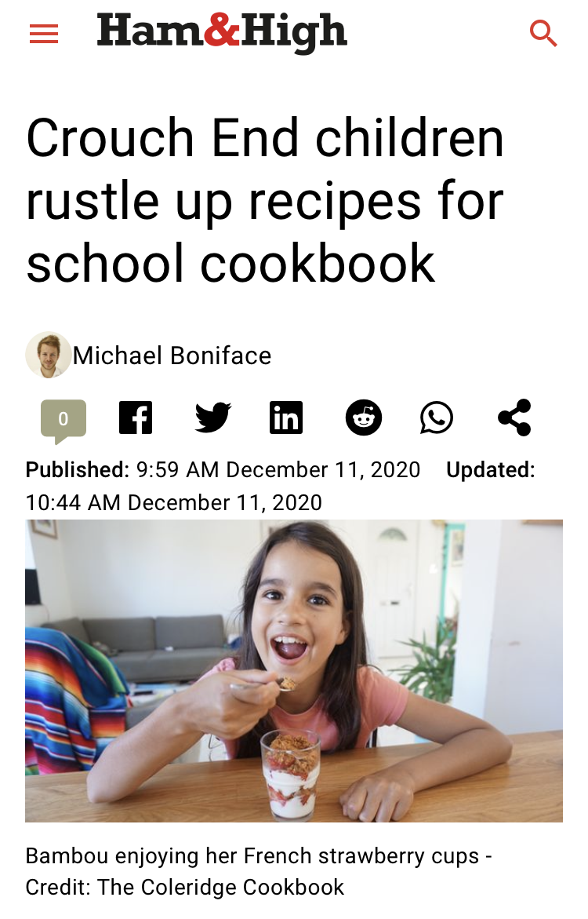
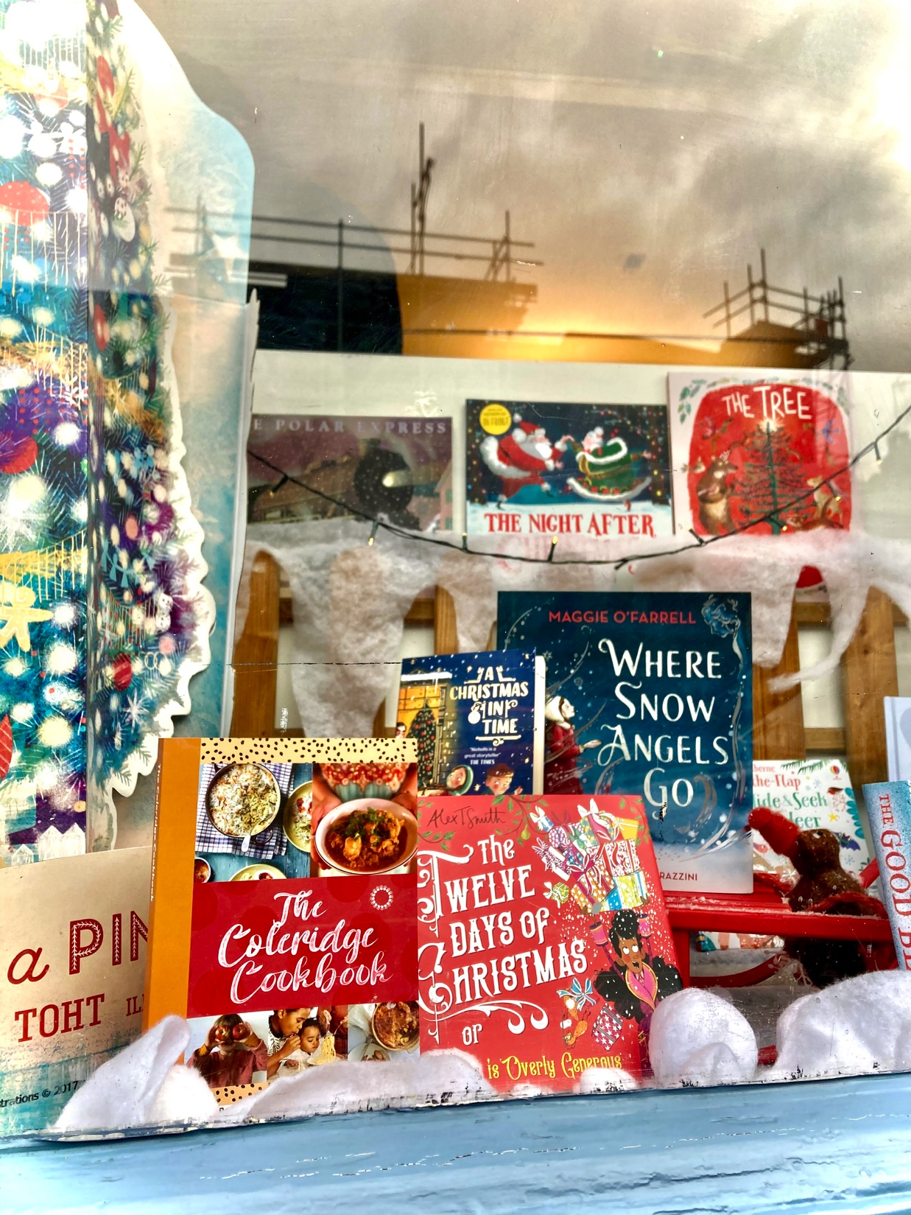
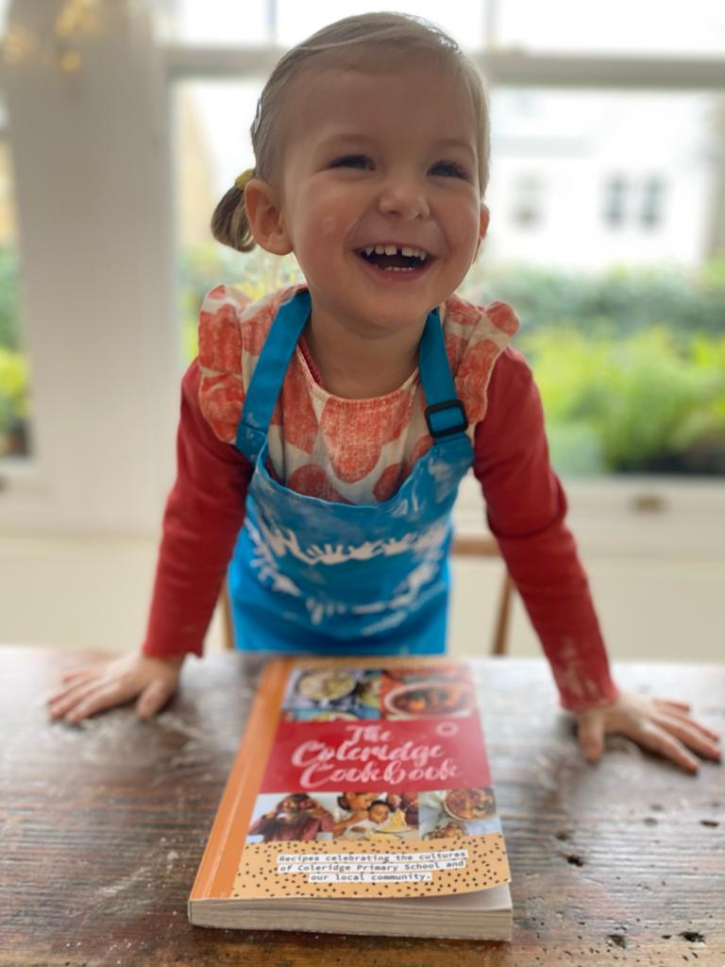
ACTIVITY REPORT
Coleridge Cookbook was our first major publication, with over 170 recipes submitted from within the school community (families and staff) and 15 local businesses

Slide 7
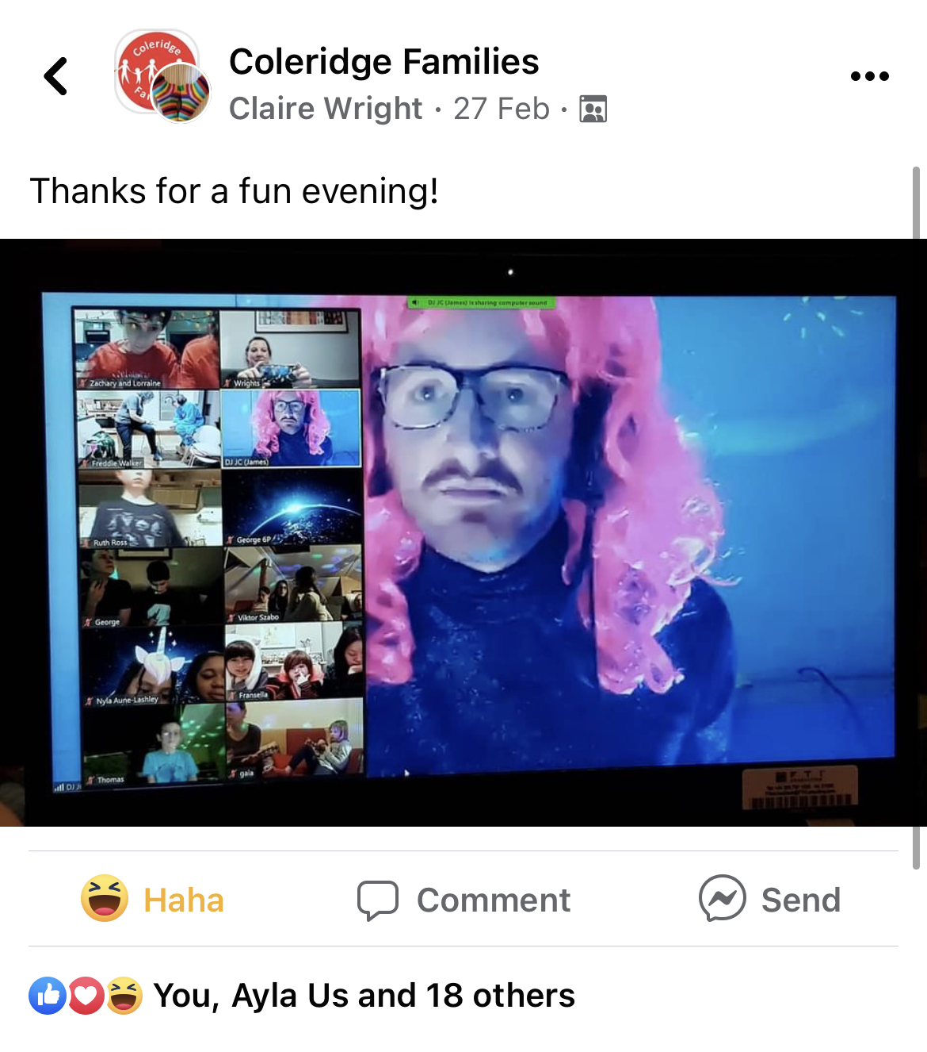
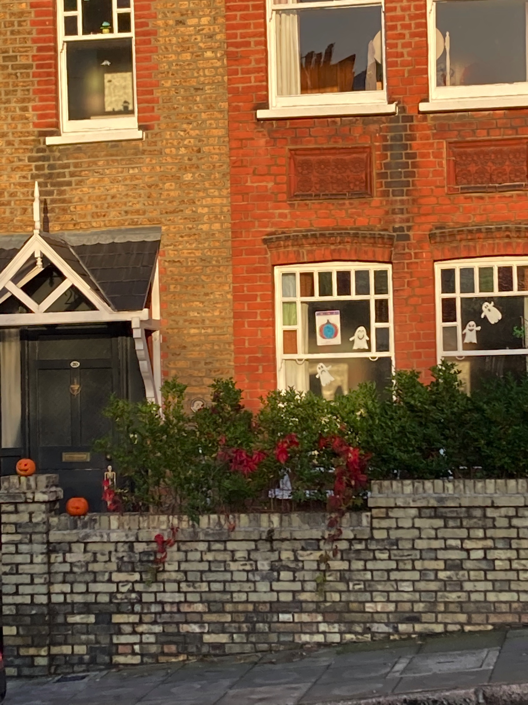
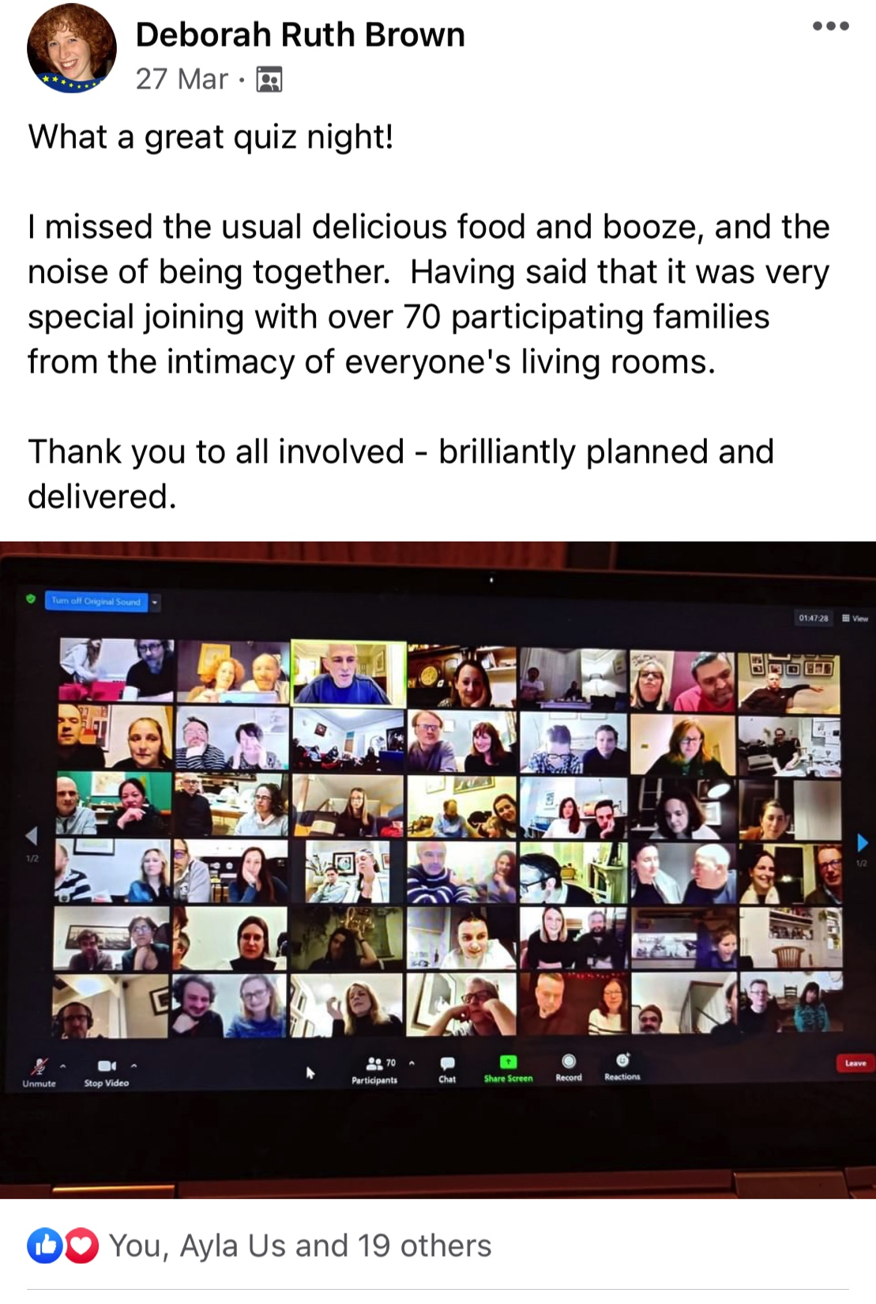
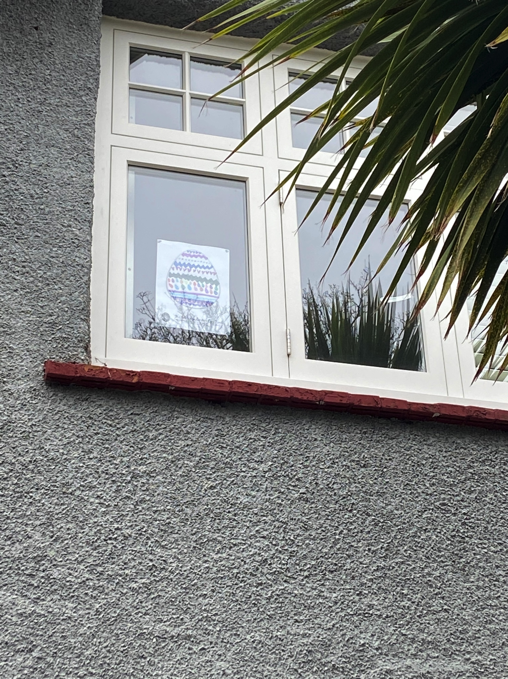
ACTIVITY REPORT

Slide 8
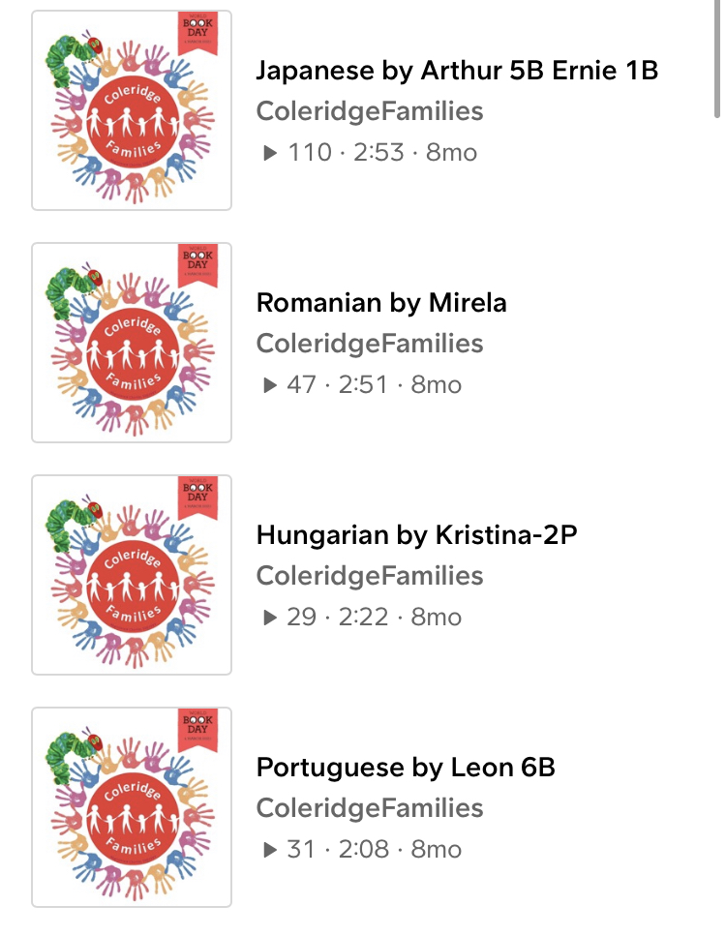
ACTIVITY REPORT
In the run up to World Book Day we have launched a Cultures of Coleridge Podcast, with families submitting their adaptations and translations of a classic story The Very Hungry Caterpillar by Eric Carle.
We received contributions in 21 languages and a number of adaptations in English language!
The podcasts are available to via SoundCloud at TinyURL.com/WBD2021-Coleridge

Slide 9
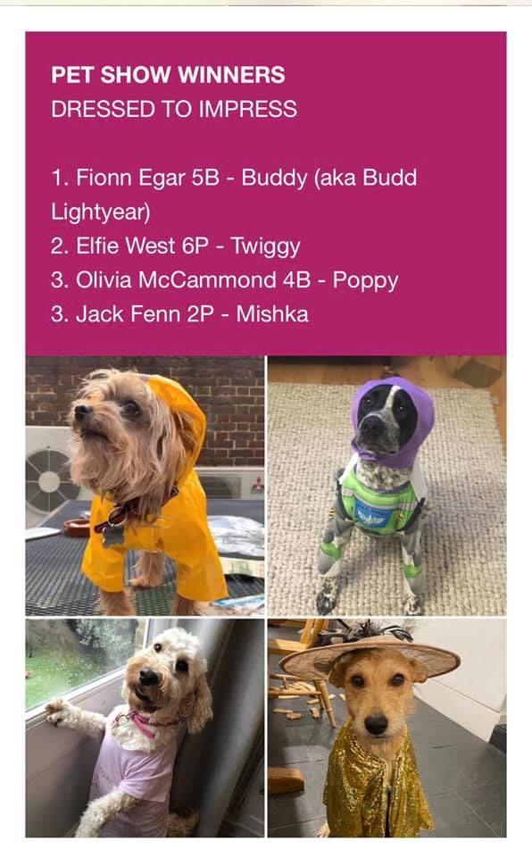
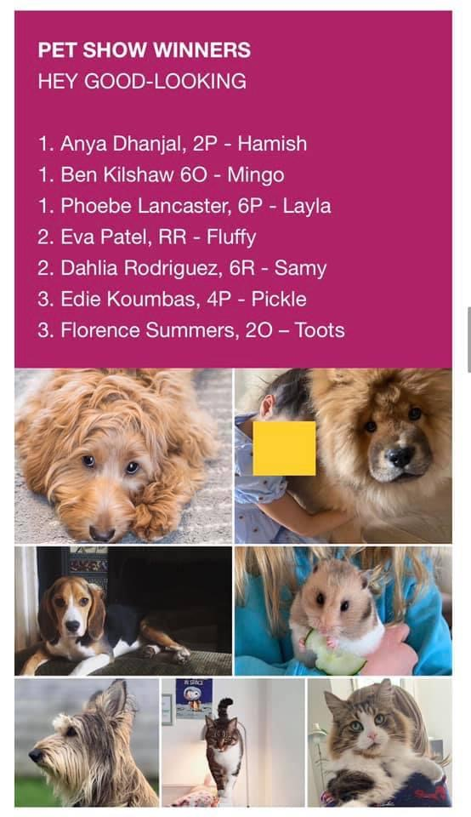
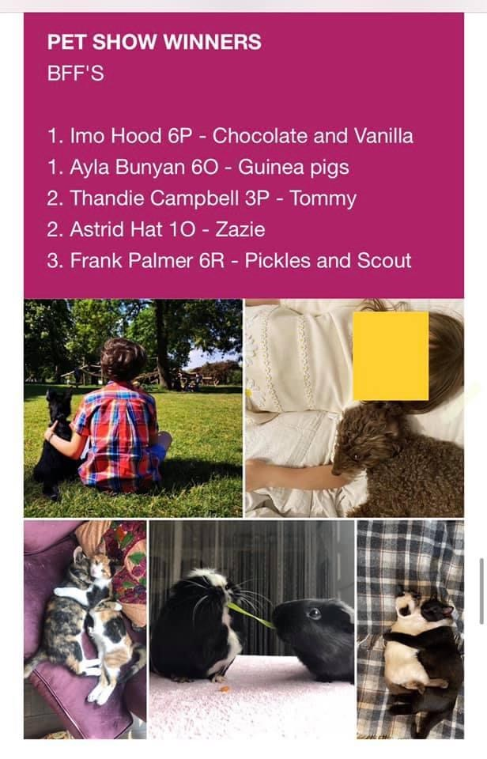
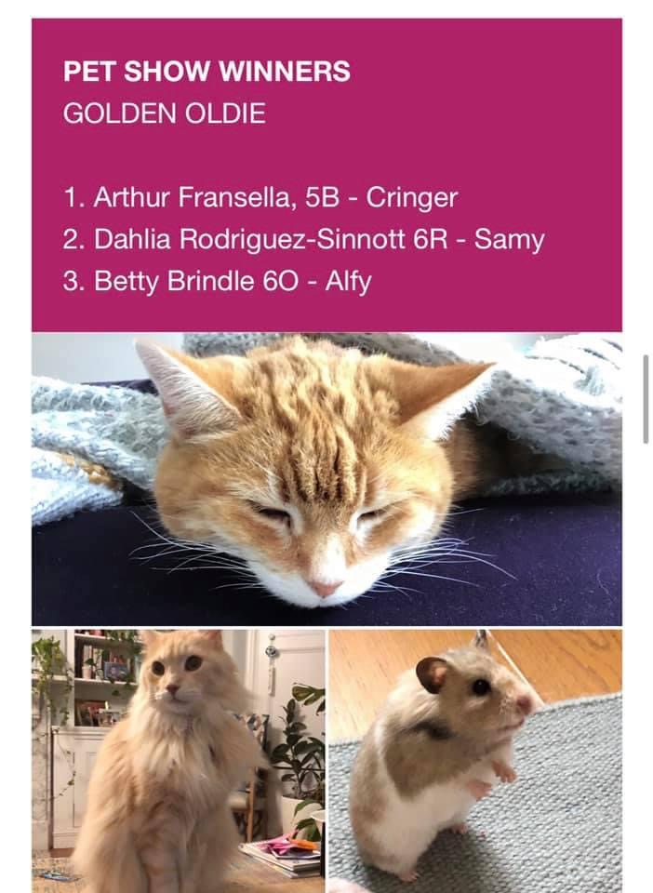
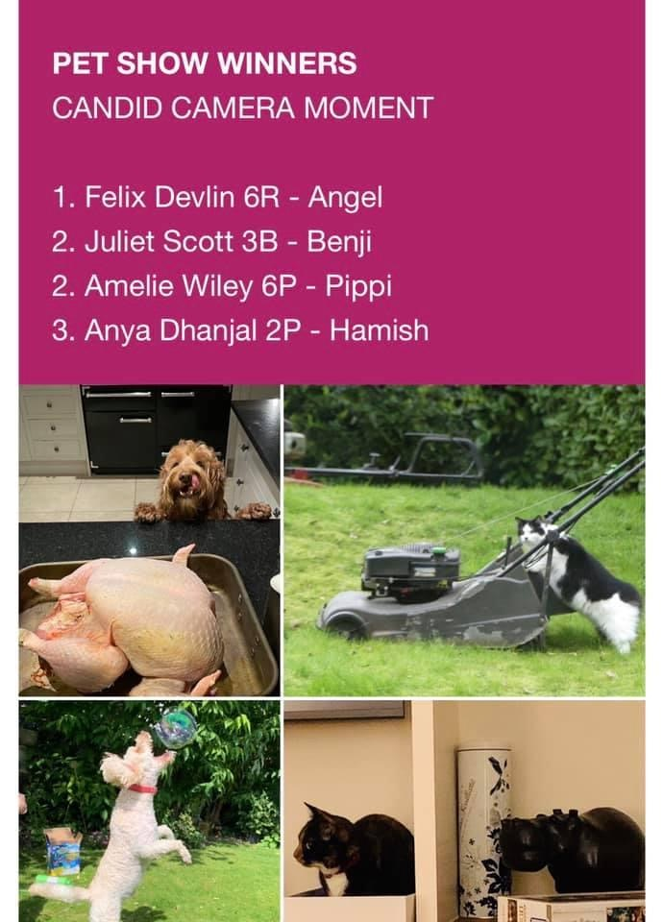
ACTIVITY REPORT
In March we launched Coleridge Jokebook with 200 submissions, including some comic strips
In the Summer Term we run our first ever Coleridge Pet Show
We received over 270 entries from across the school community!

Slide 10
ACTIVITY REPORT
In the summer term we were hoping to host a Coleridge Picnic - a scaled down version of Summer Fair, however with Covid cases on the rise the priority was to keep everyone safe and keep the bubbles open till the end of school year, as a consequence the picnic was cancelled
However we managed to run a Summer Auction online and started raising funds towards regeneration of reading corners in all the classrooms. We were donated over 50 prizes by local businesses and school community

Slide 11
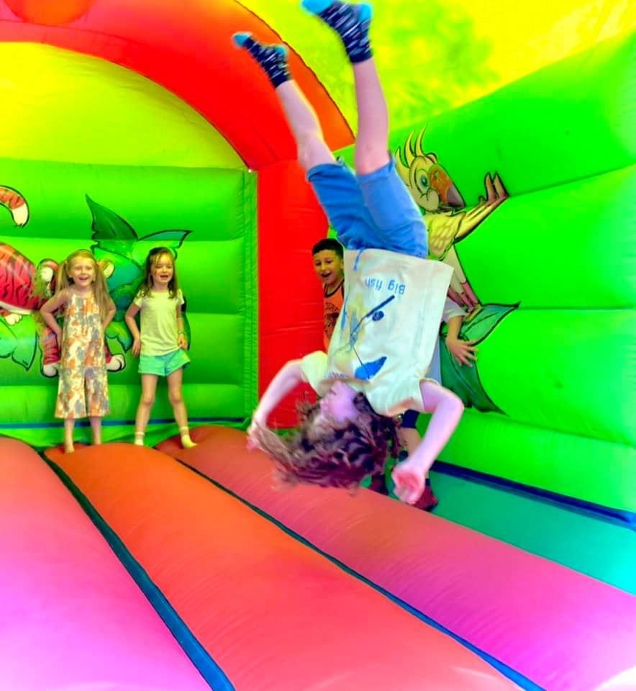
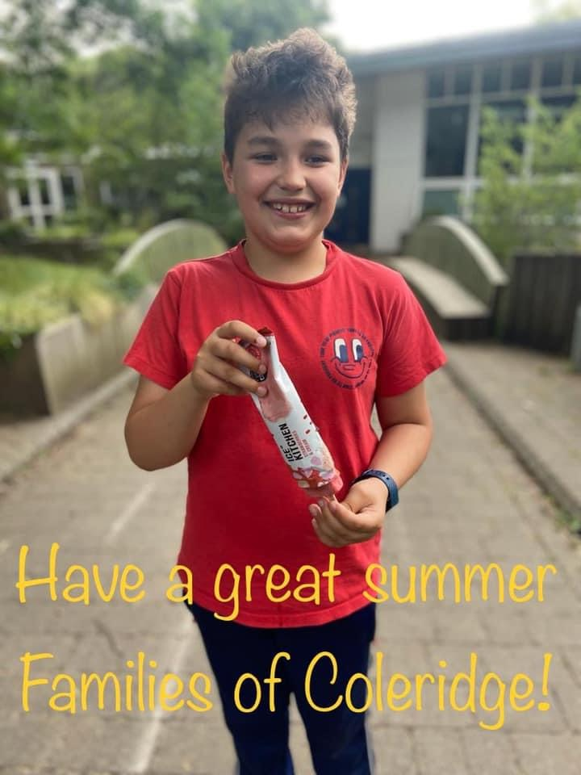
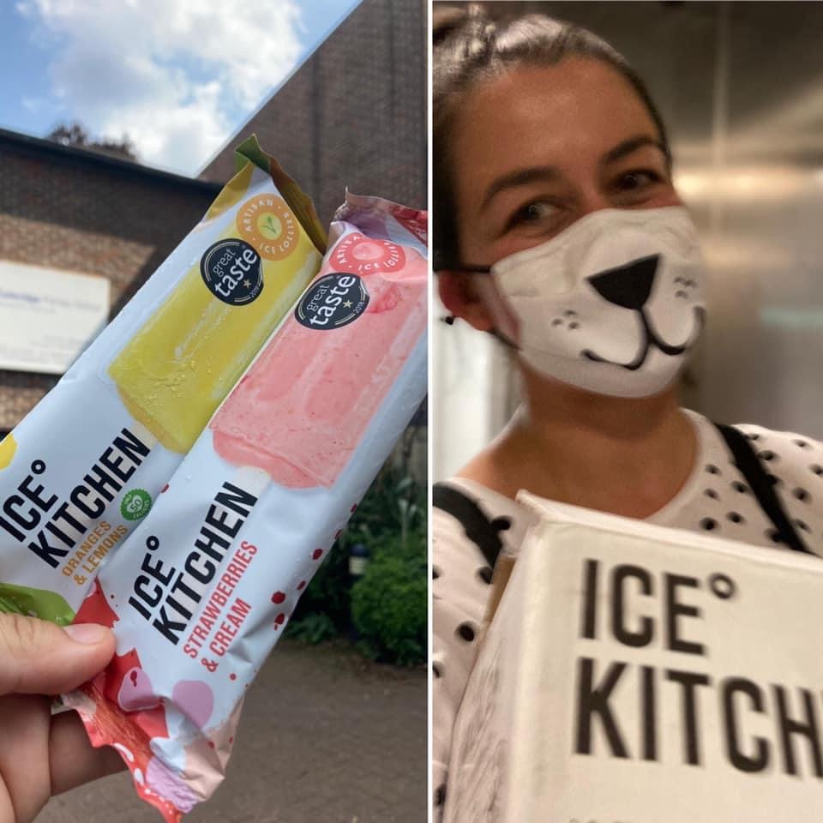
ACTIVITY REPORT
At the end of the school year the committee decided to run a number of fun activities for the children in all year groups
They included:
A show by Mr Marvel for all Year Groups (in Year Bubbles)
Bouncy Castles in playgrounds for East and West (Junior and Infant site)
Ice Lollies – courtesy of Ice Kitchen and Coleridge alumni

Slide 12
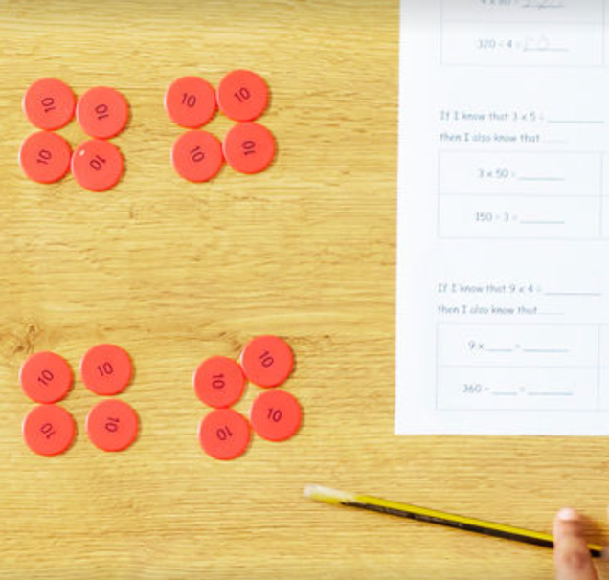
Accounts
The Treasury Team
Summary of income and expenses
Available funds
Approval of accounts

Slide 13
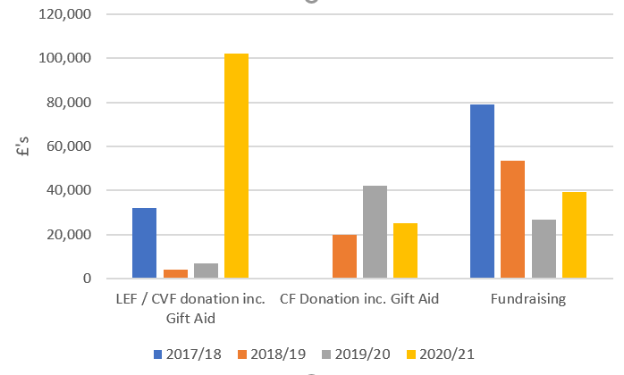
Accounts Summary of Income from Fundraising activity – 2017 -2021
Treasurers

Slide 14
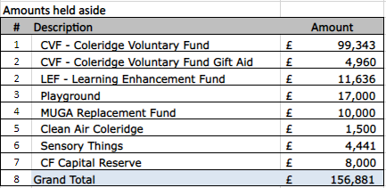
Accounts Coleridge Families (CF) Accounts – 30-Sep-21
Inv 45 received for £6,140.28 on 18th Nov. (£4k Sensory Things, £1.7k Allotment, £0.4k other)

Slide 15
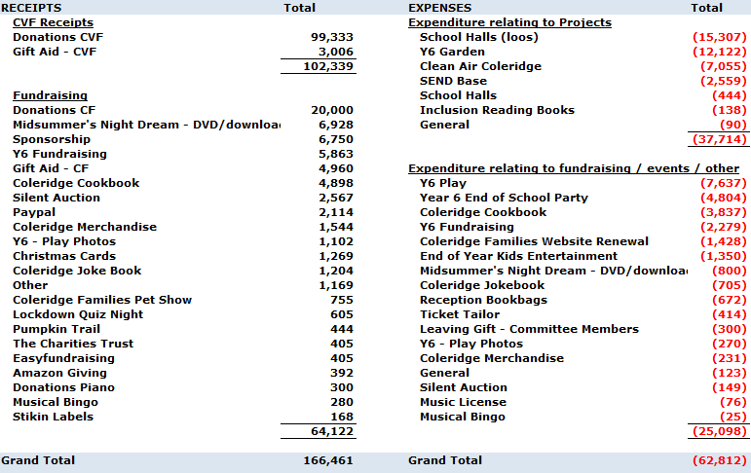
Accounts 2020-2021 CF Accounts – Income/Expense Detail
Treasurers

Slide 16
Accounts 2020-2021 CF Accounts – AOB
Gift Aid
CVF Fund
Questions
Treasurers

Slide 17
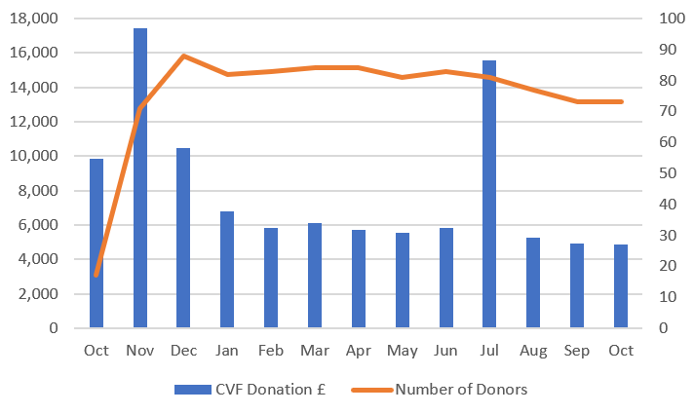
Accounts Summary of CVF Donation Oct-20 - Oct-21
Treasurers

Slide 18
School plan Why the focus on reading
Develops vocabulary and understanding of language
Improves social skills and social interactions
Improves levels of concentration, effort and focus
Build bonds and relationships
Develops empathy
Deepens children’s understanding of the world
Reduces stress

Slide 19
School plan the decline by nine
Learning to read is incredibly difficult and many children fail.
57% of 8-year-olds read five to seven nights per week. This figure drops to 35% in 9 year-olds
40% of 8-year-olds say they love reading; only 28% of 9-year-olds say the same

Slide 20
School plan Fund raising the wish list
£12,000 - Books for classrooms.
This is based on 200 books per year group (50 for nursery) with an estimate of £8 per book. Each class would be given 50 of these books, and throughout the year, they would be rotated around the 4 classrooms.
£20,000 - Book corner furniture, including shelves and soft furnishings for each classroom.
£4000 - 500 books for the east library.
The west library had a restock this year, but the infant library is in desperate need of one too.
£10,000 - Library furniture and redecoration
£10,000 - Development of outdoor reading areas

Slide 21
School plan More than fund raising
???

Slide 22
Spending plan
We have just launched a new online Coleridge Shop
ColeridgeFamiliesShop.com
We would like to restock the shop, as during the Merchandise sale that we run last year, a number of items have run out of stock
We have only recently found an appropriate storage space within the school for the Coleridge Merchandise, as our existing container is very damp and therefore not fit for storing the Merchandise
Since the launch the online store generated c. £1.3k turnover (mainly for seasonal items: Y6 Hoodie pre-orders and Christmas puddings, but there were also orders placed for our non-seasonal merchandise, though current stock is depleted)
We now feel that with the storage space sorted and new online platform that makes the ordering process much easier, it is time to restock
We propose to place an order for restock items up to the value of £2,000

Slide 23
SpendiNg Plan
Item | Number of items | Cost per item | RPP | Profit per item | Total Profit
T-shirts | 83 | 3 | 7.00 | 4.00 | 332.00
Long sleeve t-shirts | 18 | 4 | 10.00 | 6.00 | 108.00
Zipped hoodies | 100 | 9.75 | 18.00 | 8.25 | 825.00
Hooded jumpers | 92 | 8.5 | 16.00 | 7.50 | 690.00
Bobbled hats | 18 | 5.28 | 10.00 | 4.72 | 84.96
TOTAL |  |  |  |  | 2,039.96
Transaction costs @2% |  |  |  |  | 40.80
Net profit |  |  |  |  | 1,999.16
The table above is an illustration of profitability of Coleridge Merchandise, new stock only. The number of items as per suggested restock

Slide 24
Spending plan
We would like to look into ways of upgrading / refitting our storage container
The storage container is located at the back of the school, at the end of the parking lot
It has no windows and no electricity
It has developed a lot of mold, as it has not been sufficiently aired and some of the items that were stored there might not have been sufficiently dry before they were stored inside.
There is currently no spending allocated on the container, but it should be addressed in the near future as we risk the container becoming of no practical use due to its state

Slide 25
Vacant roles on the Committee
Coleridge Families is always on a lookout for new members! We aim to have at least 2 people covering each role
We are currently looking for volunteers in the following areas:
Fireworks Committee
Event Management
Rep Coordination
Coleridge Merchandise
Admin
Sponsorships
Coms
Website

Slide 26
AOB
Thank you for coming!
If you haven’t yet, please sign up to our Newsletter
TinyURL.com/CFNewsletterSignUp
Follow us on Social Media:
TinyURL.com/FacebookColeridgeFamilies
Instagram.com/ColeridgeFamilies

